Slide 1
DevOps and Kubernetes in Azure – From 0 to 100
@diegocasati diego.casati@microsoft.com
Diego Casati
Senior Software Engineer
Commercial Software Engineering
Microsoft Canada

Slide 2
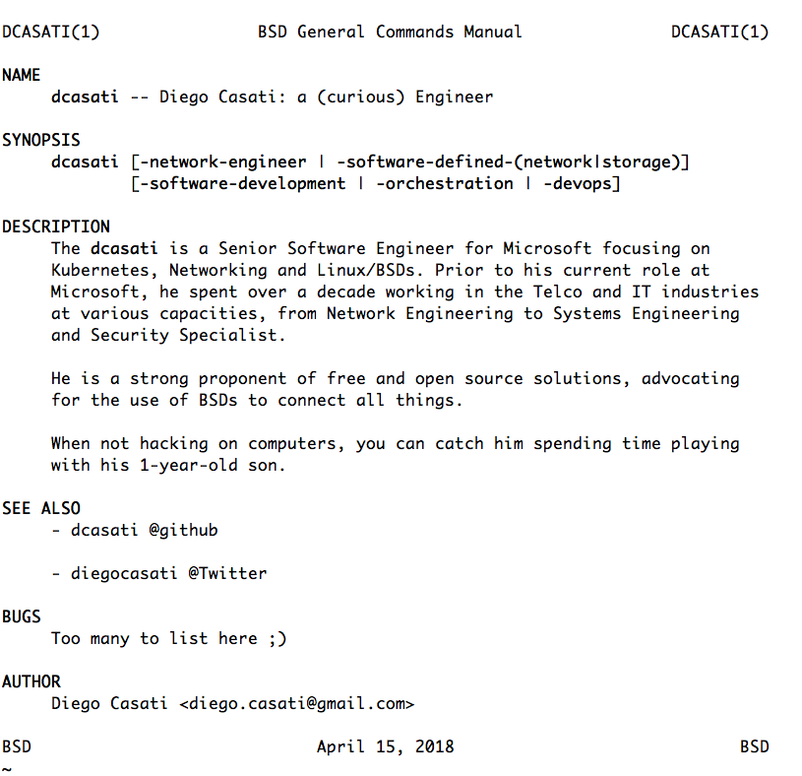

$ whoami
Diego Casati
Senior Software Engineer
Commercial Software Engineering - Microsoft

Slide 3
Why should you care about containers and microservices ?

Slide 4
In reality, you shoudn’t …

Slide 5
Should care about applications

Slide 6
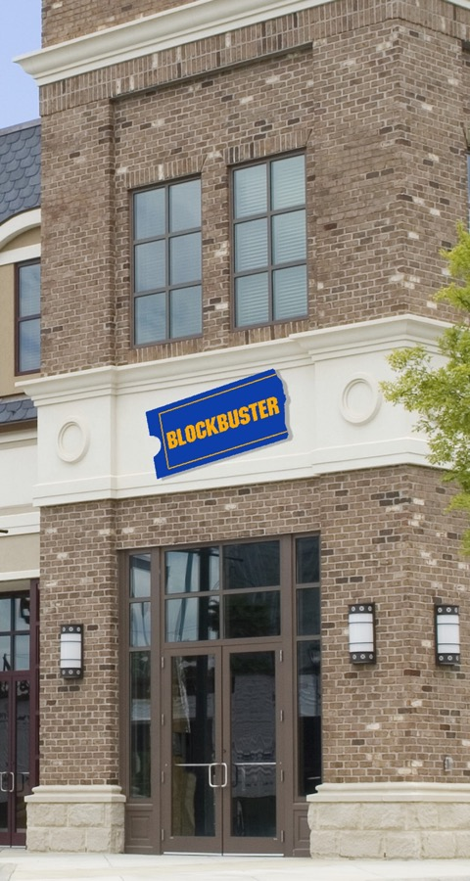







Application and Innovation

Slide 7
Our world is changing
Today
Long application cycles
Monolithic apps
Servers and VMs
Less data
Distinct infrastructure and operations teams
Tomorrow
Rapid innovation
Loosely-coupled apps and microservices
Serverless
Big Data
Service-focused DevOps teams
Servers
Services

Slide 8
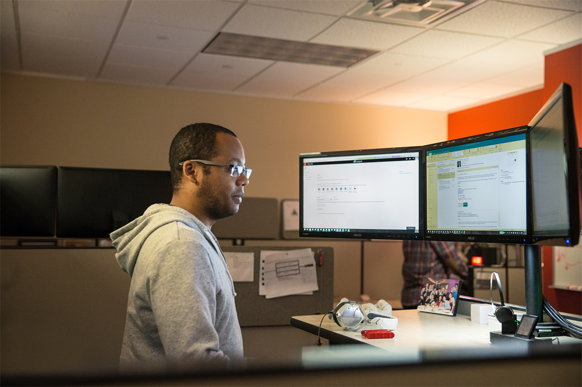
Where do developers spend time…
Maintaining existing applications
“Fixing” existing applications
Adding features to existing applications
Fixing the feature someone else added to the existing applications
Building a new application
(maybe … if there’s time)

Slide 9

Where do application admins spend time…
Maintaining existing applications
Re-deploying new versions
of existing applications
Diagnosing issues with
existing applications
Troubleshooting issues from feature additions to the existing applications
Deploying a new application

Slide 10
From traditional app to modern app
APP
Existing Application
Modern Infrastructure
rehost as VMs or refresh to modern container platform.
Containerize Applications
Re-architect apps for scale with containers.
Modern Microservices
Add new services or start peeling off services from monolithic code.
On-Premises
Infrastructure Platform
IaaS
Infrastructure Platform
“lift & shift”
Containers
Container Platform
PaaS
Application Platform
Serverless

Slide 11





DevOps: the three stage conversation
DEV
OPS
1
People
2
Process
3
Products

Slide 13
Let’s go Cloud Native !

Slide 16
Containers

Slide 17


Slide 18
Docker (Containers) vs VMs

Slide 19
The container advantage
Traditional virtualized environment
VM
VM
Low utilization of container resources
Application
Con.
Con.
Application
Containerization of applications and their dependencies
Con.
Con.
Hypervisor 2
Host OS
Hardware

Slide 20
The container advantage
Containerized environment
Migrate containers and their dependencies to underutilized VMs for improved density and isolation
VM
VM
Con.
Con.
Decommission unused resources for efficiency gains and cost savings
Con.
Con.
Docker Engine
Host OS
Hardware

Slide 21
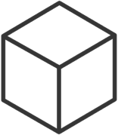
The container advantage
Fast iteration
Agile delivery
Immutability
Cost savings
Efficient deployment
Elastic bursting
For developers
For IT

Slide 22


Industry analysts agree
“By 2020, more than 50% of enterprises will run mission-critical, containerized cloud-native applications in production, up from less than 5% today.”

Slide 23
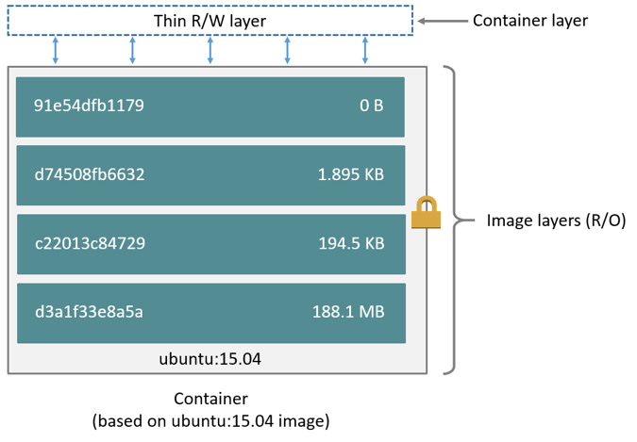
Docker Container Anatomy
Image source: https://docs.docker.com/engine/userguide/storagedriver/imagesandcontainers/#images-and-layers

Slide 24
Dockerfile
FROM golang:alpine
RUN mkdir /app
COPY tinywww /app
CMD ["/app/tinywww"]

Slide 25
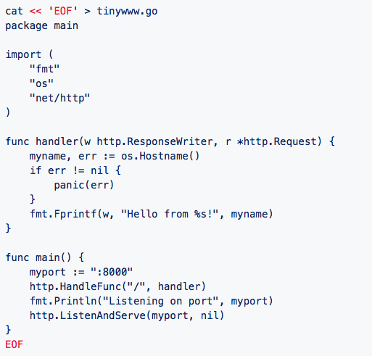
The Application

Slide 26
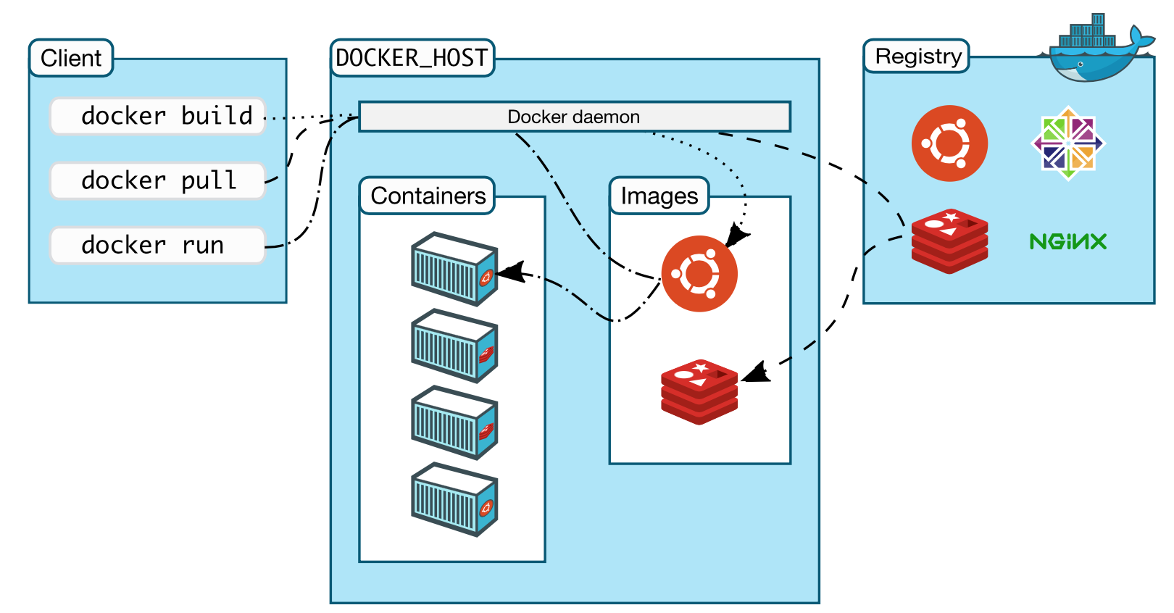
Docker architecture

Slide 27
Demo - Docker

Slide 28
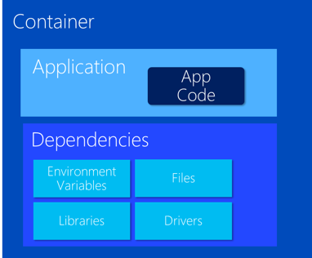
VM Host
VM Host
VM Host
VM Host
But things get
complicated quickly

Slide 29
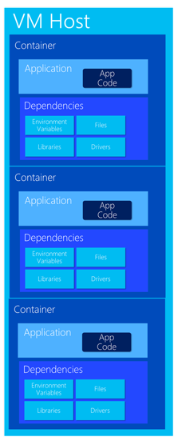
Very Quickly

Slide 30
Container Orchestration

Slide 31
The elements of orchestration
Scheduling
Affinity/anti-affinity
Health monitoring
Failover
Scaling
Networking
Service discovery
Coordinated app upgrades

Slide 32
Kubernetes: the de-facto orchestrator
Portable
Public, private, hybrid, multi-cloud
Extensible
Modular, pluggable, hookable, composable
Self-healing
Auto-placement, auto-restart, auto-replication, auto-scaling

Slide 33
Kubernetes: empowering you to do more
Deploy your applications quickly and predictably
Scale your applications on the fly
Roll out new features seamlessly
Limit hardware usage to required resources only
Notes:
x

Slide 34
Azure Container Service - AKS

Slide 35



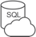








Azure Container Service (AKS)
Azure Kubernetes Service (AKS)
Azure Container Instances (ACI)
OSBA
App Service
Azure Container Registry (ACR)
Partner services
Azure services
PaaS
Azure Container Registry
OpenShift
SQL Database
Azure Kubernetes Service (AKS)
Service Fabric
Batch
Pivotal Cloud Foundry
Redis Cache
ACS Engine
Open Service Broker API (OSBA)
Docker Enterprise Edition
CosmosDB
Virtual kubelet
Mesosphere DC/OS
And more!
Azure Container Instances (ACI)
Azure Virtual Machines
Virtual Machine Scale Sets (VMSS)
Azure
IaaS

Slide 36
Azure Container Service (AKS)
Azure Kubernetes Service (AKS)
A fully managed Kubernetes cluster
Azure Container Instances (ACI)
Managed control pane
Automated upgrades, patches
Easy cluster scaling
Self-healing
Cost savings
Azure Container Registry
Managed
Application architect
Applications
Open Service Broker API (OSBA)
Operations
Kubernetes
Infrastructure architect
Docker
Azure infrastructure services

Slide 37
Kubernetes without AKS

Slide 38
Kubernetes with AKS

Slide 39
Getting Started with AKS
$ az aks create -g myResourceGroup -n myCluster --generate-ssh-keys
\ Running ..
$ az aks install-cli
Downloading client to /usr/local/bin/kubectl ..
$ az aks get-credentials -g myResourceGroup -n myCluster
Merged "myCluster" as current context ..
$ kubectl get nodes
NAME STATUS AGE VERSION
aks-mycluster-36851231-0 Ready 4m v1.8.1
aks-mycluster-36851231-1 Ready 4m v1.8.1
aks-mycluster-36851231-2 Ready 4m v1.8.1

Slide 40
Managing an AKS cluster
$ az aks list –o table
Name Location ResourceGroup KubernetesRelease ProvisioningState
------------------ ---------- -------------- ------------------- -------------------
myCluster westus2 myResourceGroup 1.7.7 Succeeded
$ az aks upgrade -g myResourceGroup -n myCluster –-kubernetes-version 1.8.1
\ Running ..
$ kubectl get nodes
NAME STATUS AGE VERSION
aks-mycluster-36851231-0 Ready 12m v1.8.1
aks-mycluster-36851231-1 Ready 8m v1.8.1
aks-mycluster-36851231-2 Ready 3m v1.8.1
$ az aks scale -g myResourceGroup -n myCluster --agent-count 10
\ Running ..

Slide 41
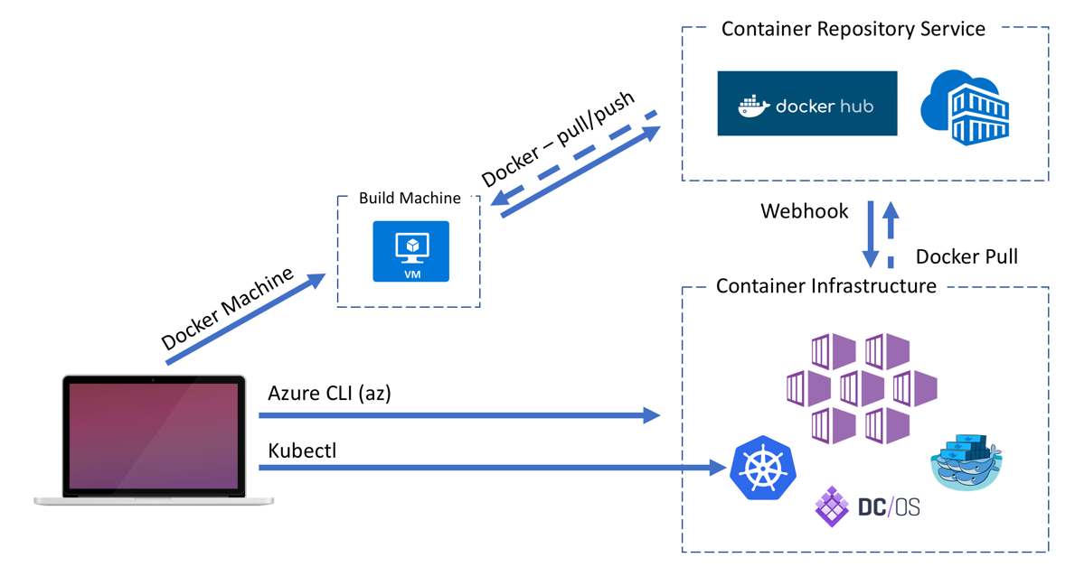
Container Workflow to Deployment

Slide 42
Demo – AKS

Slide 43
Container Workflow to Deployment Pipeline

Slide 44
Demo – VSTS Kubernetes Pipeline

Slide 45
What’s Next?

Slide 46
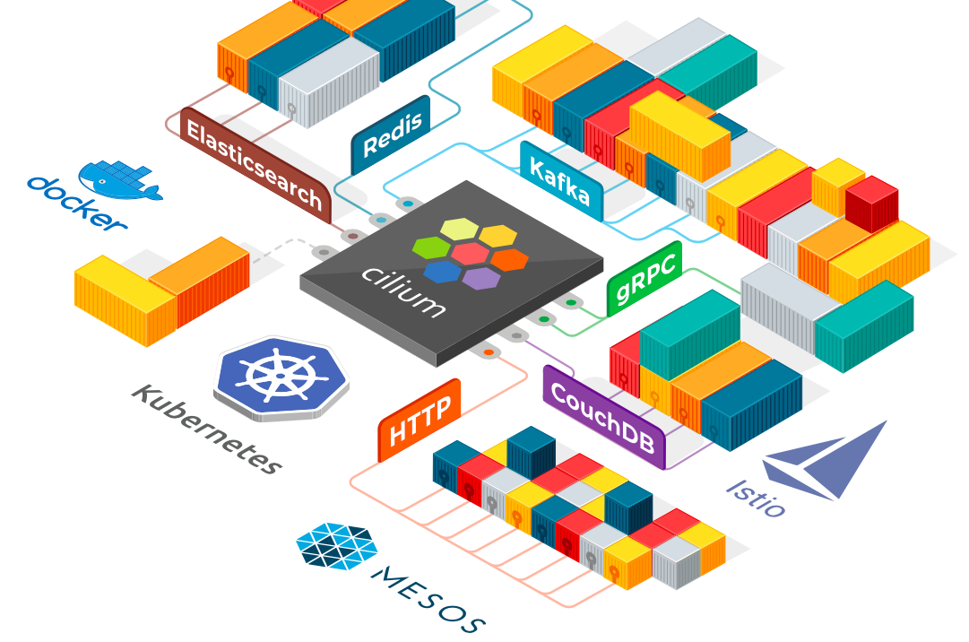

Slide 47
Thank You!
diegocasati @twitter
@DiegoCasati diego.casati@microsoft.com

